Slide 1


Group 2
Juilee Salunkhe
Pranav Radhakrishna
Akshay Bhala
Nishit Nakhrani
Krupal Vora
Prankur Garg

Slide 2
Agenda
04
1
Goals and Expectations
03
Architecture and Demo
02
Business Idea
Scope of project
01

Slide 3
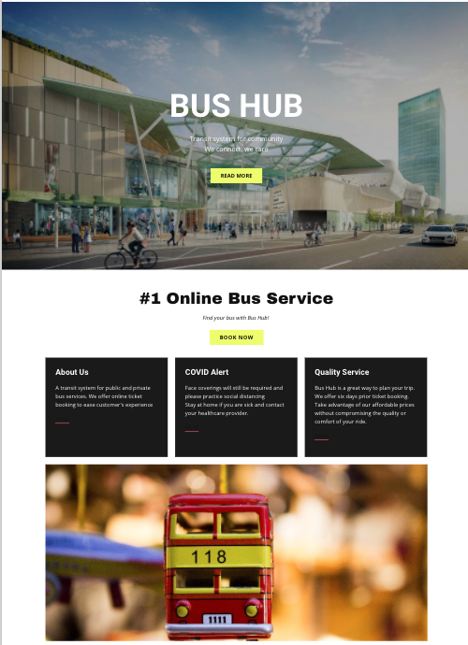
2
Business Idea
Digitization and automation of bus pass system. This project is intended to enhance and streamline the current manual bus pass system for community bus service e.g. Centro
Manual passes -> E-pass system
More convenience
Cost saving

Slide 4
Competitor Analysis
3
01
NJ Transit have an online option of selling tickets. Taking the system as an inspiration we are developing an online system for Centro Bus service. Transforming physical bus pass to online bus pass system.
How are we different?
02
We are Public bus service initiative. Competitor like Bus bud only compares private bus services.
03
Proposing a system of dynamic price comparison for all the private bus services. E.g. Megabus, Greyhound

Slide 5

Stakeholders
4
Investors
Public/Private Authorities
Developers
.
.

Slide 6
Functionalities
5
01
Sale of weekly/monthly/yearly online bus passes and tickets through a website/mobile application.
02
Generating unique barcodes for tickets/passes
03
Add a device to scan the barcode generated on the bus pass or ticket in every bus
04
Comparing prices across different private bus companies.

Slide 7
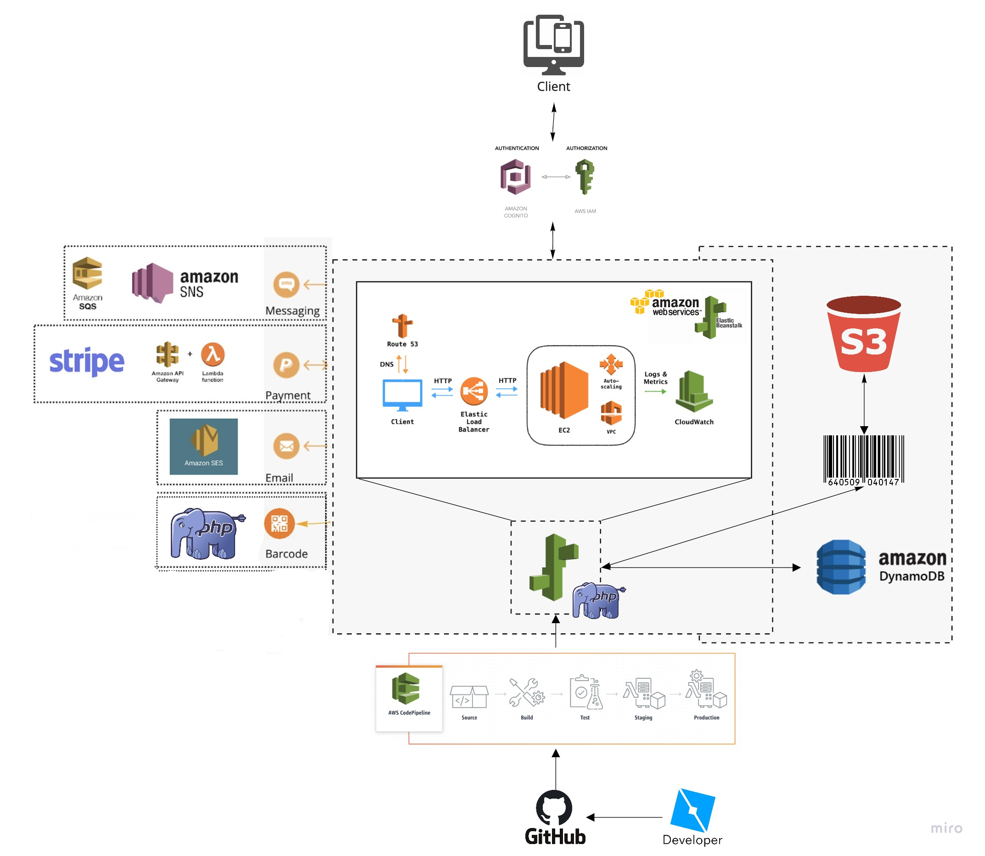

6

Slide 8
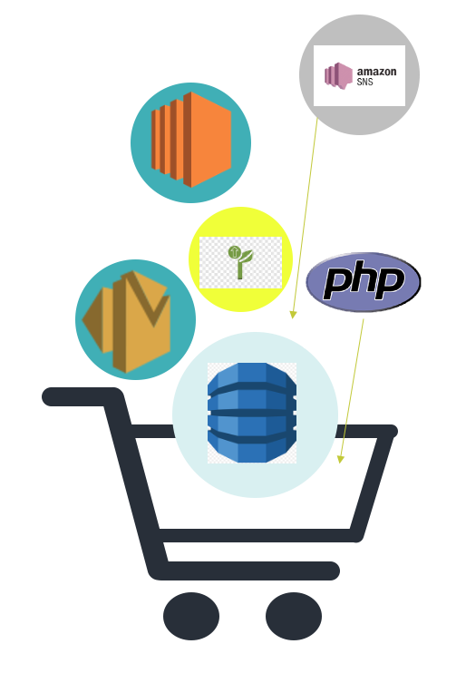
Cost Model for AWS services
7
Amazon S3 | First 50 TB / Month - $0.023 per GB | $0.115/month (5GB approx /month) Although it will grow exponentially every month with increase in customers. Expected to be around $10-$15 at the end of first year.
Amazon DynamoDB | 25 GB of data storage, $0.25 per GB-month thereafter Read/Write request are $0.25/mil and $1.25/mil respectively | Free for initial years since our dataset is small
Amazon Elastic BeanStalk | Using windows with sql standard. T3a.xlarge with 4 CPUs, 16 GiB memory, AWS EBS Only 0.704 per Hour. | $500/month approx. per instance or $6,000/Year
Amazon CodePipeline | 1 free pipeline per month in free tier | Free since we are only using 1 pipeline.
Amazon Cognito | First 50,000 MAUs - $0.050, Next 50,000 MAUs - $0.035 Next 900,000 MAUs - $0.020 | $4,250 for the first year(for approx. 100,000 customers). Expected to increase in the future. (Expected to be $400-$500 approx. for first month based on 8,000 customers.)
Amazon SNS | $0.00645 per SMS(First 100 SMS are free) | $1,548 (for 8,000 customers/month) We calculated as 1 SMS per day per customer
Amazon SES | $0 for the first 1,000 emails you receive, and $0.10 for every 1,000 emails you receive after that. | $700/month. EVery month he price may vary with the increase in customers
Amazon Lambda | $0.20 per 1 Mil Requests, $0.0000166667 for every GB-sec (1M free requests per month and 400,000 GB-sec of compute time) | Free for initial years since our dataset is small
Amazon gateway | 1M Rest API calls, 1M HTTP API calls, 1M messages each received and 750,000 connection minutes per month | Free for initial years. May increase with increase in customers.

Slide 9


Cost Model for Non AWS services
8
Stripe (third party) | pay-as-you-go pricing, 2.9% + 30¢ per successful card charge | May vary depending on the price of bus tickets (Paid by the customer)
Equipment cost(RFID installation) | For a total of 234 buses. This cost will include installation charges as well. This is a one time cost | $70,200
Maintenance cost for equipment |  | $300/month
Developmer’s cost |  | Revenue - total cost ( aprrox 10K/ month/ employee)
Maintenance cost for website |  | $300/Month
Advertisement from centro |  | 1%-2% of the ad amount
$75k
First Month Cost
First Month cost | Includes equipment cost | Approx. $75,000
Monthly cost | Excludes equipment cost | Approx. $4,800/month

Slide 10

Revenue Model
9
5%
30%
Commission Model
Advertisement Model
We estimate 8,000 customers will use our website per month spending $20 on an average.
This will generate $8,000 revenue per-month from commissions considering the Centro Price Model
Considering the total expenditure we estimate to generate $53,000 profits.
We plan to implement Click-Per-Cost (CPC) model which get an average of 10,000 clicks per month. The average cost is $0.50 to $3.00
We currently have 3 webpages and we estimate to generate $50,000 revenue per - month from advertising

Slide 11


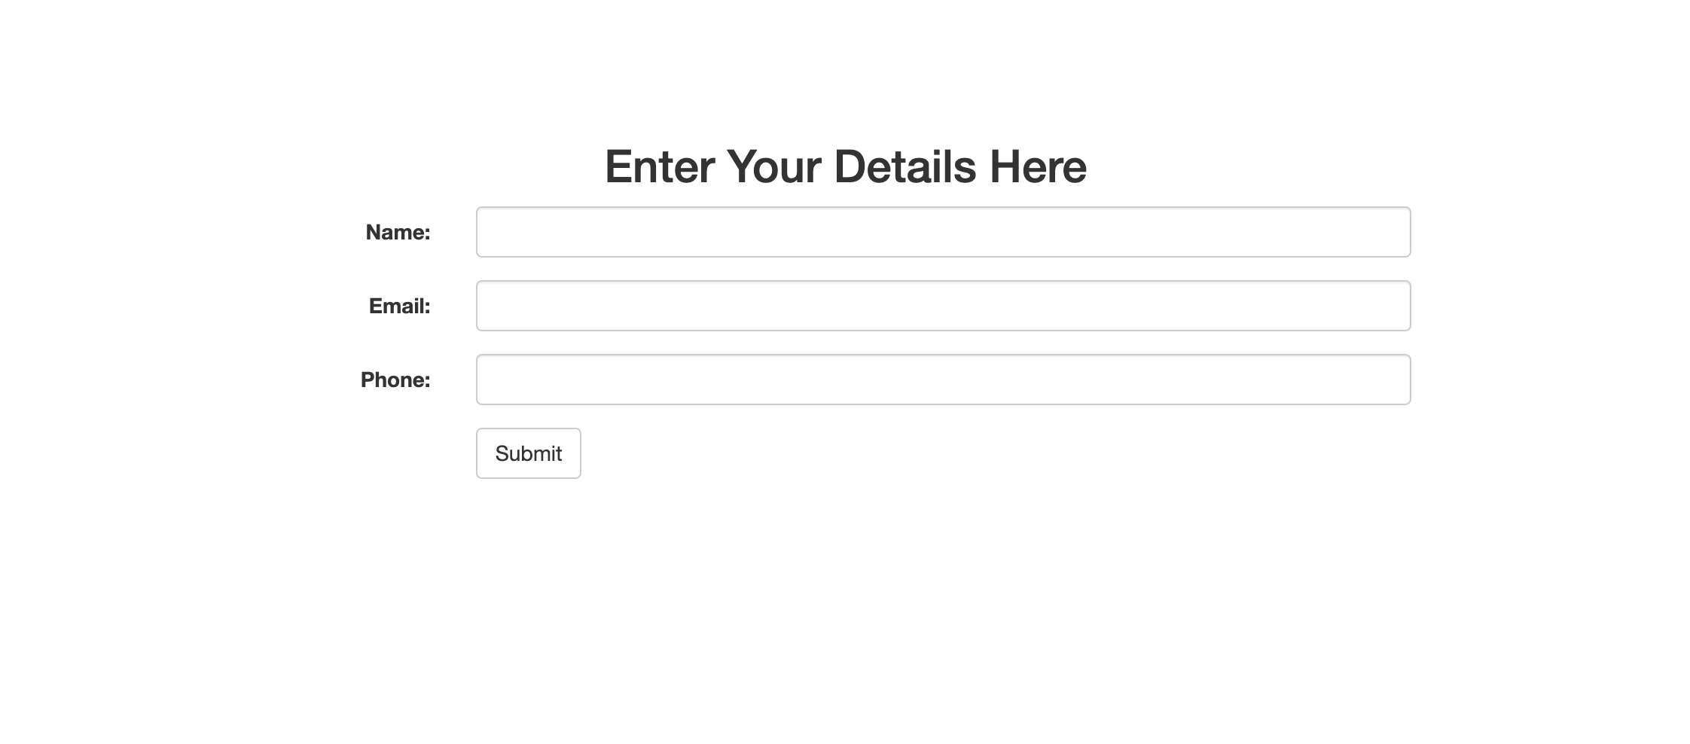
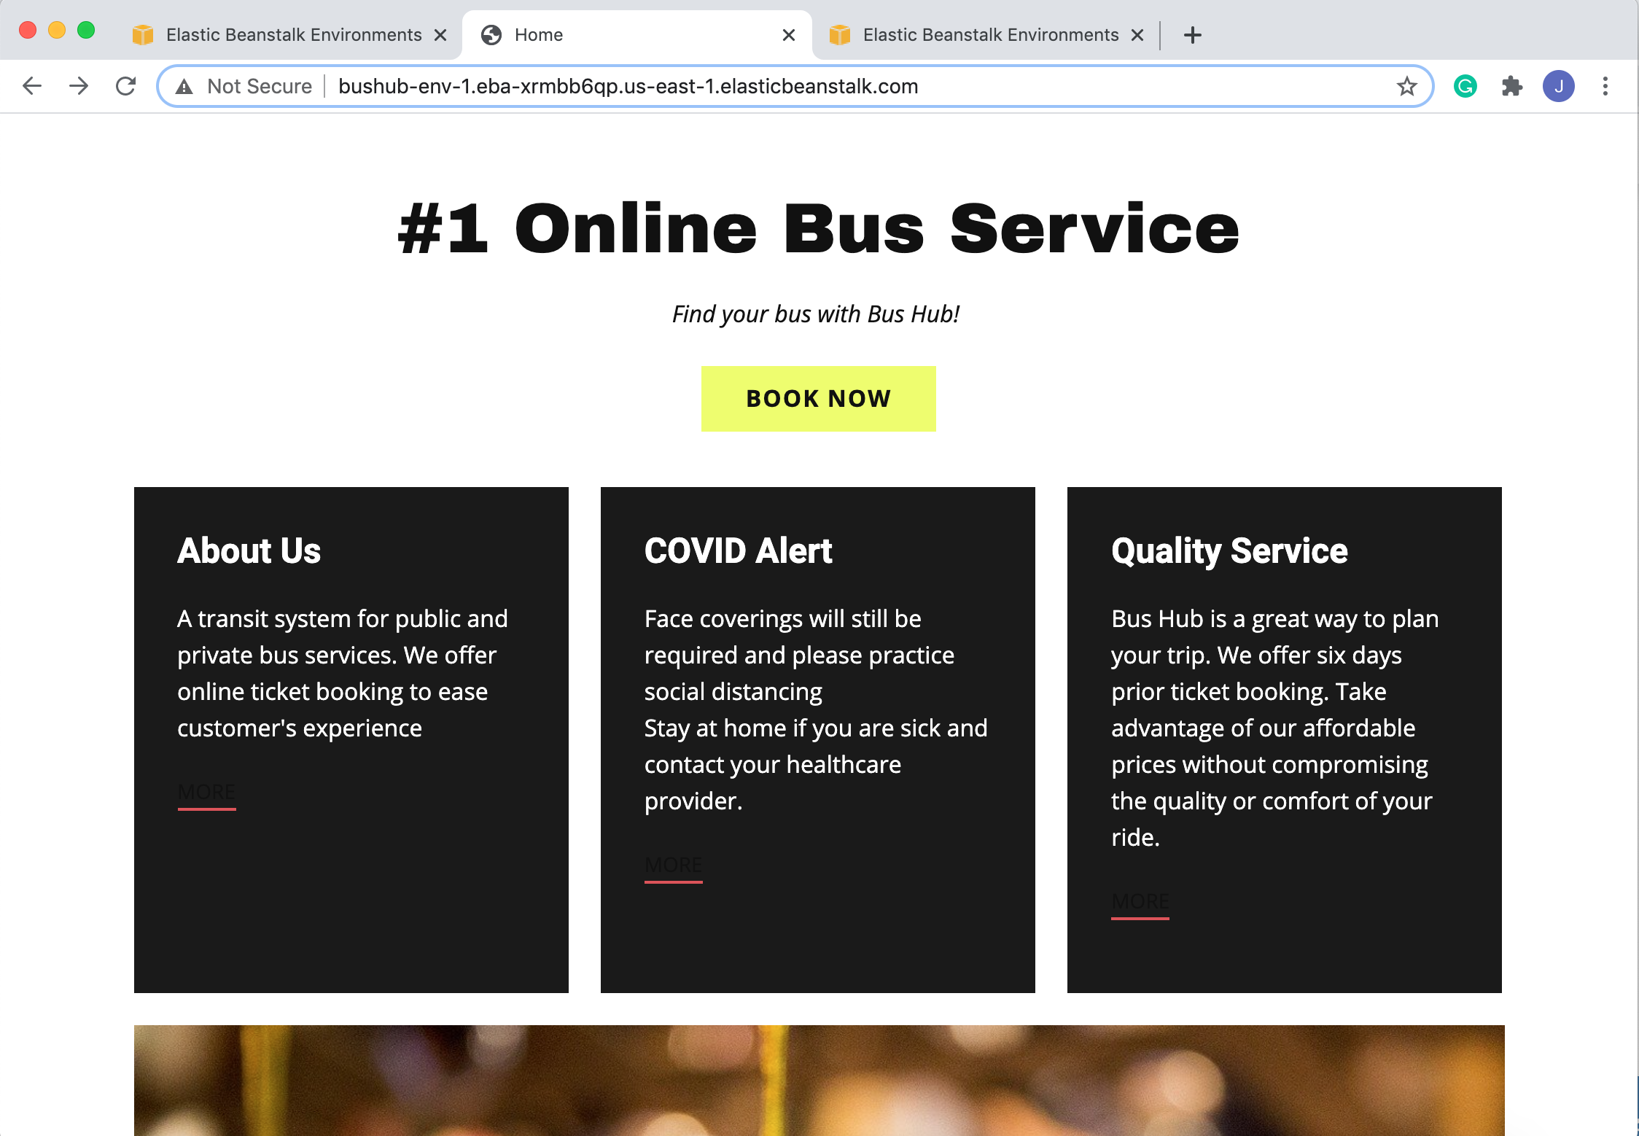

10
Implemented Functionality
Demo:
Customer chooses a ticket on website
Selects the ride and fills out the form
Barcode is generated
The data gets stored in DynamoDB table
Barcode gets stored in S3 Bucket

Slide 12
Our Functionality
11
04
S3 Bucket
02
01
Code Pipeline
03
Elastic beanstalk
DynamoDB

Slide 13
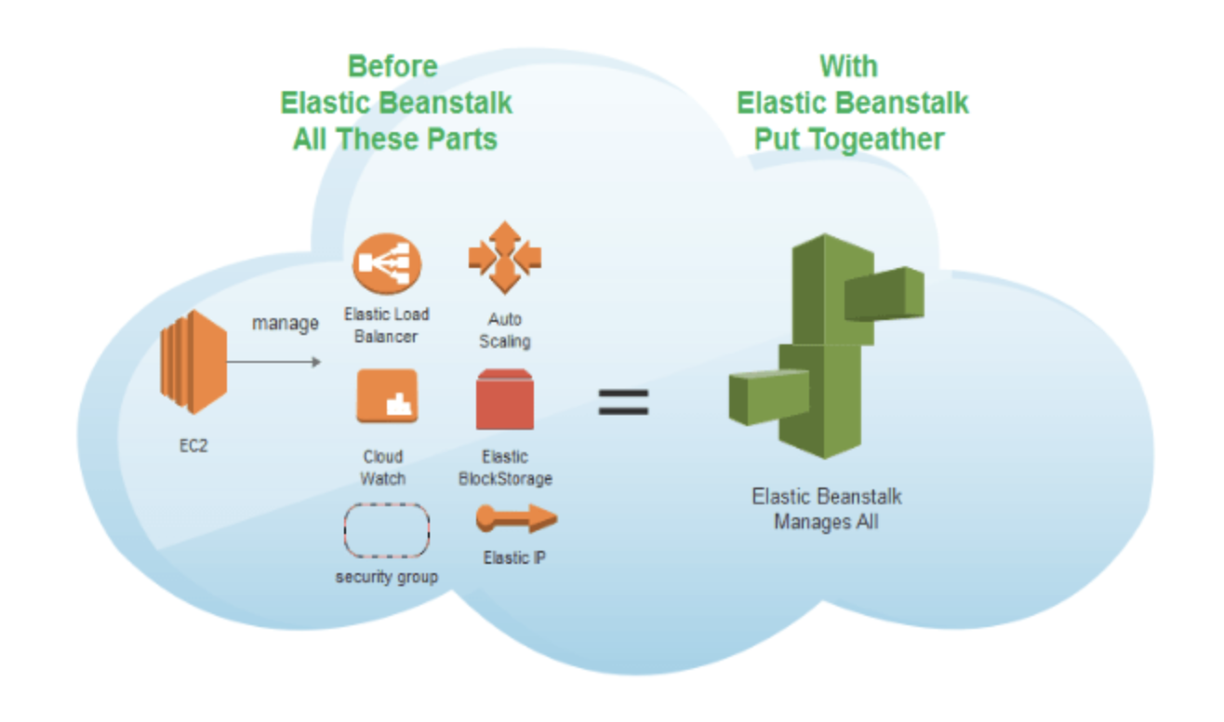
12
Elastic Beanstalk
Deployment & Scaling
1
AWS Elastic Beanstalk is an easy-to-use AWS service for deploying and scaling web applications and services developed with PHP.
2
With Elastic Beanstalk, you just have to upload your code and Elastic Beanstalk automatically handles the deployment, from capacity provisioning, load balancing, auto-scaling to application health monitoring. At the same time, you retain full control over the AWS resources powering your application and can access the underlying resources at any time.

Slide 14
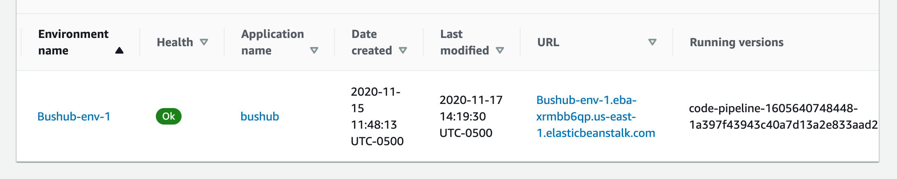
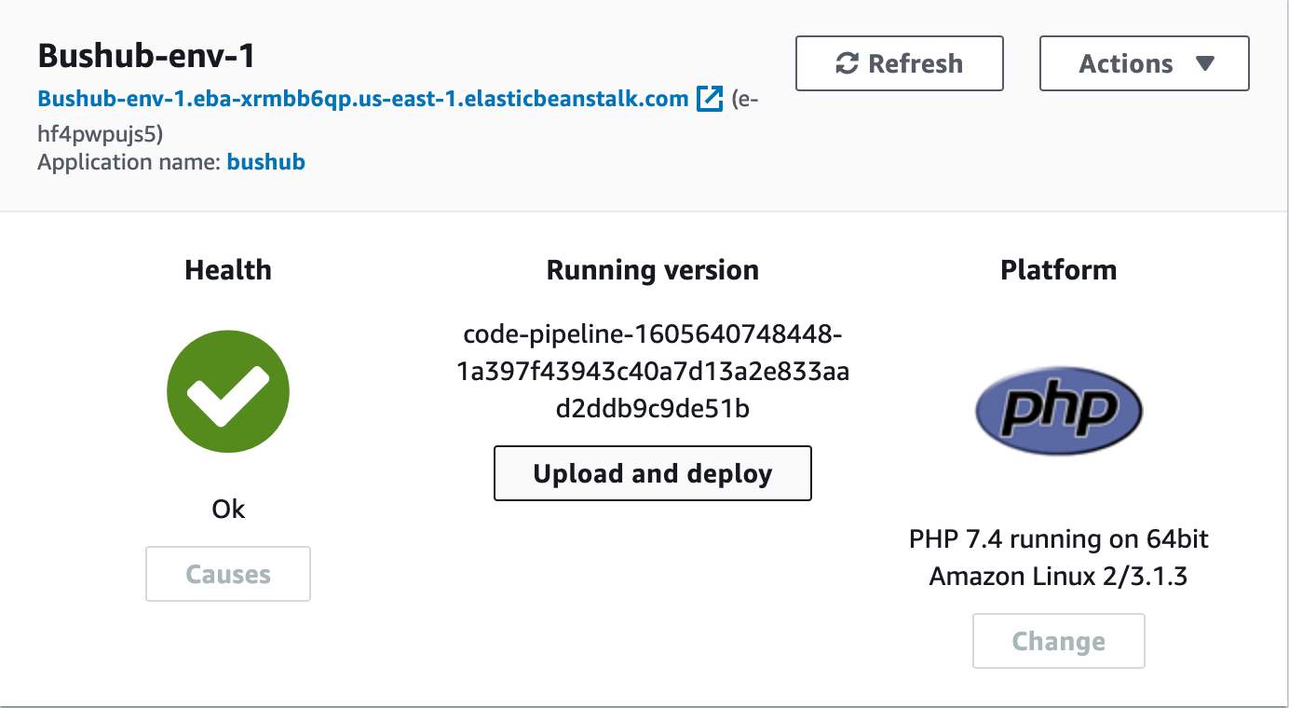
12
13
Elastic Beanstalk
Difference b/w EC2 and Elastic Beanstalk
EC2 | AWS Elastic Beanstalk
EC2 is a service of Amazon which helps you to create and launch servers in the Amazon cloud. | A Beanstalk infrastructure contains EC2 instances, databases, security and scaling groups and many more AWS components.
These servers are called instances and they are configured behind a load balancer when we create a Beanstalk application | It is beneficial for the purpose of deploying elastic cloud applications.
With a single instance, we can launch n number of instances. | Beanstalk doesn’t charge for the additional resources you have been provided with.
You pay for the time and for what you have used. | Elastic Beanstalk supports a PHP stack. You can keep your site in version control and easily deploy to your environment whenever you make changes
2

Slide 15
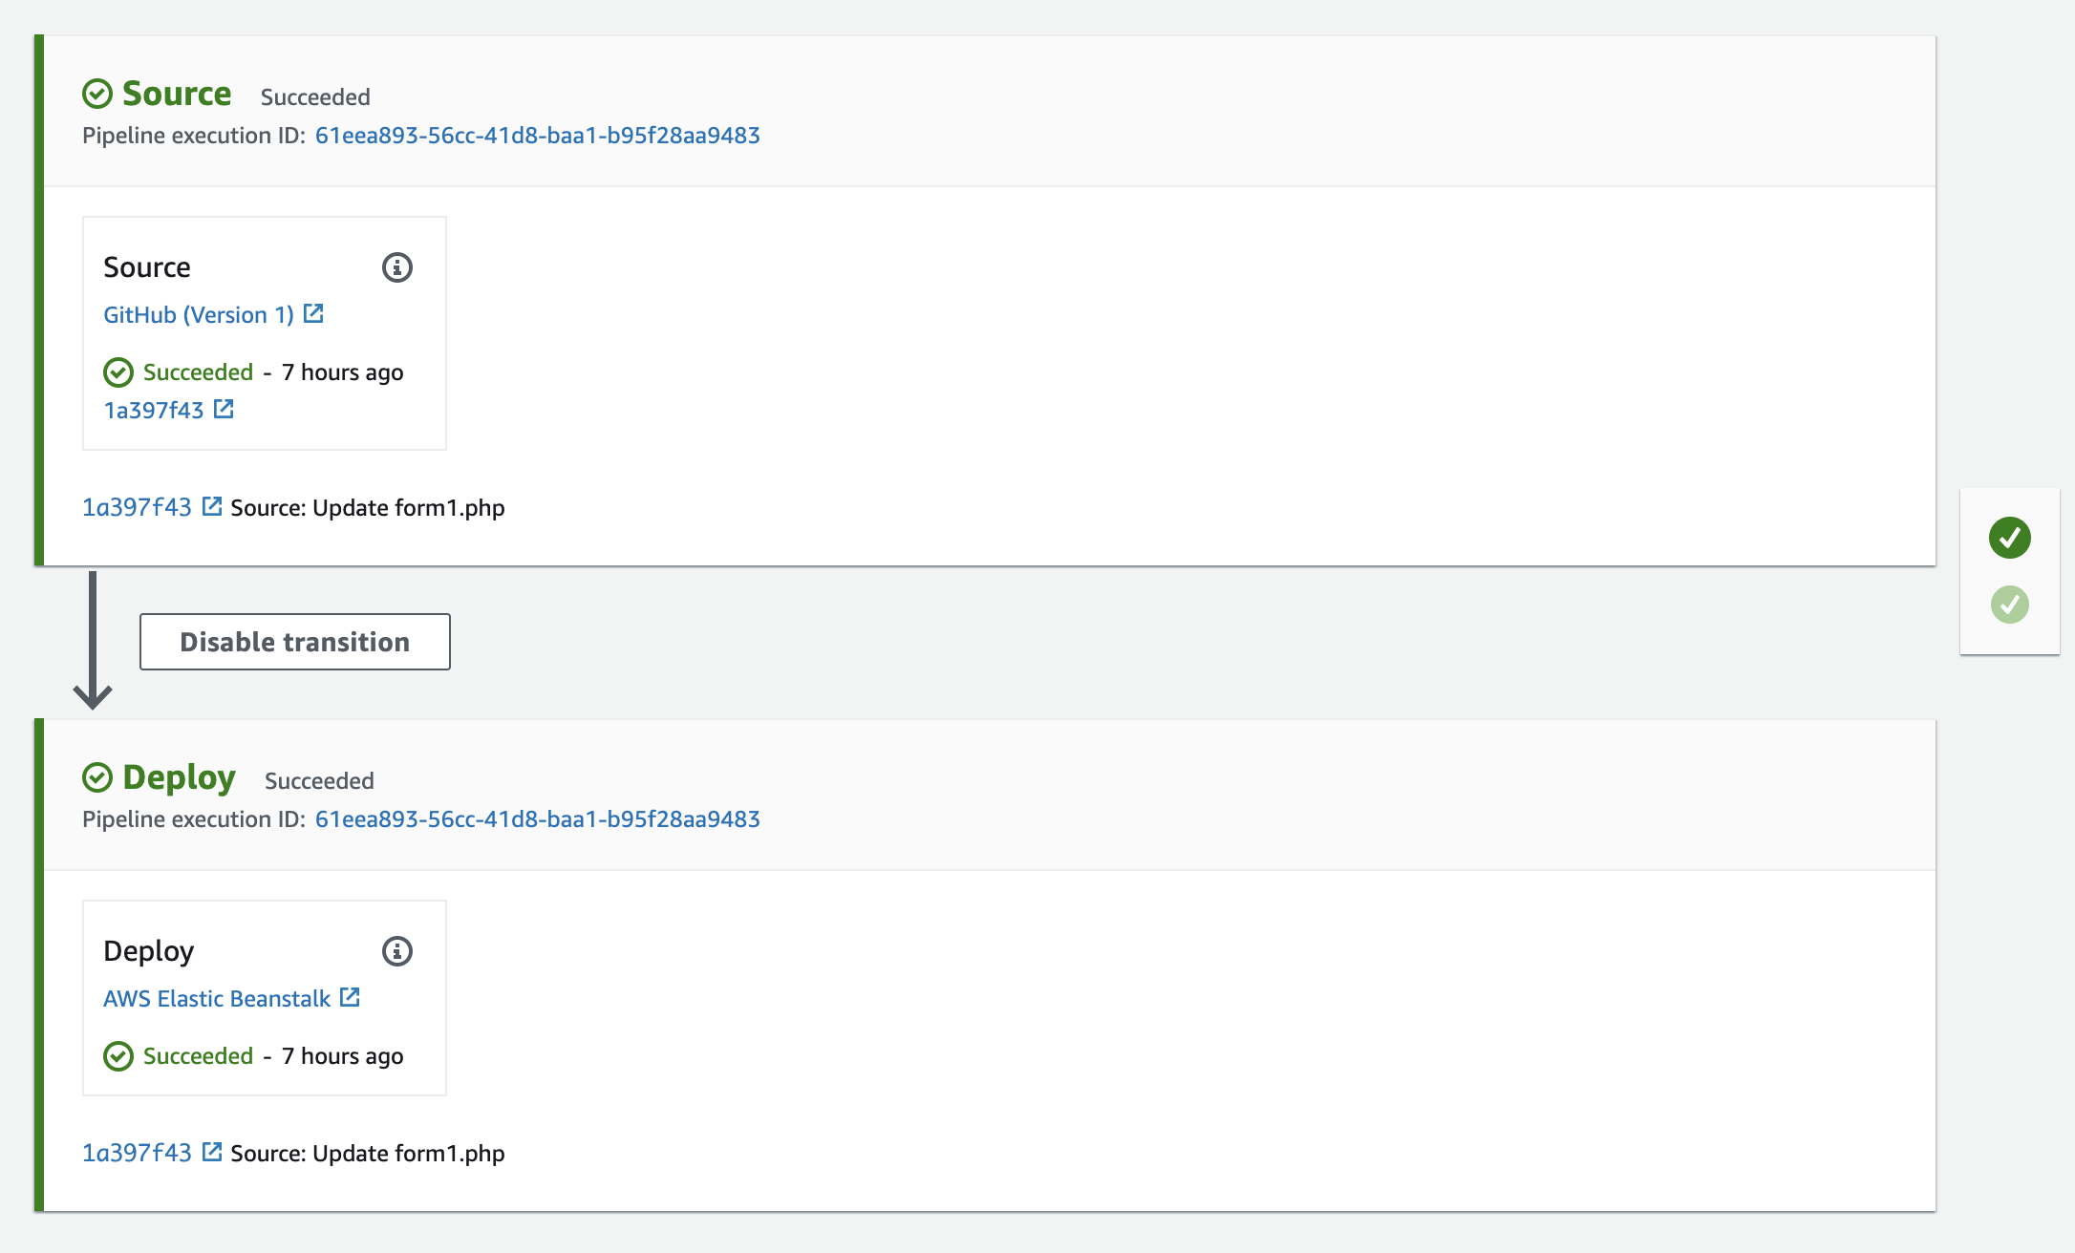
14
Code Pipeline
Automates the build, test, and deploy phases
1
AWS CodePipeline is a fully managed continuous delivery service that helps you automate your release pipelines for fast and reliable application and infrastructure updates.
2
AWS CodePipeline starts with a GitHub repo. It automatically creates a trigger action for any commits to the GitHub repository, so that you don’t have to automatically trigger the pipeline release.
Notes:
The CodePipeline starts with a GitHub repo. It automatically creates a trigger action for any commits to the GitHub repository, so that you don’t have to automatically trigger the pipeline release.

Slide 16
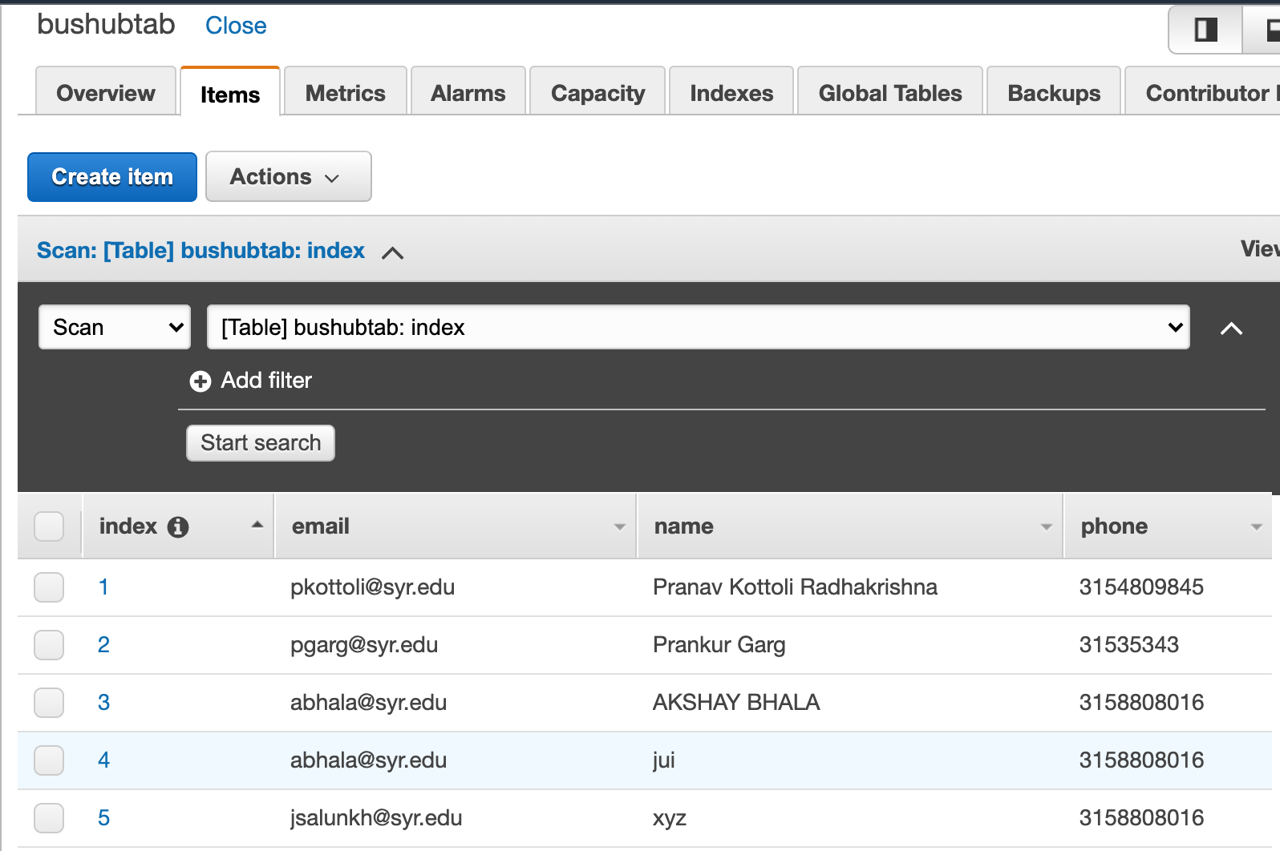
15
AWS DynamoDB
Fully managed NoSQL database
1
With DynamoDB, you can create database tables that can store and retrieve any amount of data and serve any level of request traffic.
2
On-demand backup and restore.DynamoDB automatically spreads the data and traffic for your tables over a sufficient number of servers to handle your throughput and storage requirements, while maintaining consistent and fast performance.
Notes:
Amazon DynamoDB is a fully managed NoSQL database service that provides fast and predictable performance with seamless scalability. DynamoDB automatically spreads the data and traffic for the table over a sufficient number of servers to handle the request capacity specified by the customer and the amount of data stored, while maintaining consistent and fast performance.

Slide 17
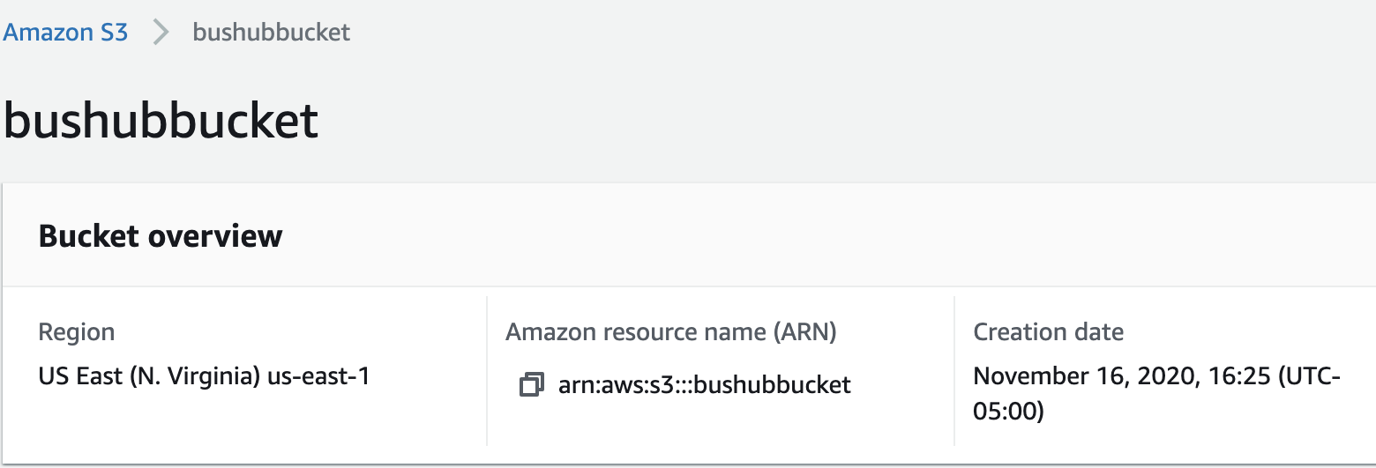
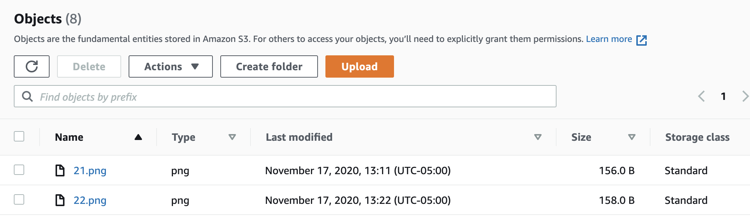
16
AWS S3
Store and retrieve any amount of data!
1
Amazon S3 has a simple web services interface that you can use to store and retrieve any amount of data, at any time, from anywhere on the web. It gives any developer access to the same highly scalable, reliable, fast, inexpensive data storage infrastructure that Amazon uses to run its own global network of web-sites. .
In our application Elastic Beanstalk uses this bucket to store barcode, that are required for the proper operation.
2

Slide 18
Demo
17
www.bushub.com

Slide 19
Future Goal
18
01
Dynamic Pricing
02
Geolocation
03
Online Seat Selection
04
Including other services such as Airline

Slide 20
Thank You
Questions?

